Slide 1

Back to School after coronavirus/COVID-19
Notes:
SENCo’s – this short training package is to be used alongside the Wakefield Educational Psychology Service (EPS) COVID-19 advice for schools – transition and back to school.
The purpose of this training is to present some of the psychological theories within the context of transition to support children and young people.
There are notes with each slide to help you, but you don’t necessarily need to read them all.

Slide 2
Overview
This presentation has been developed by Wakefield Educational Psychology Service (EPS) and modified by Herefordshire EPS with the intention of it being delivered in school by your SENCo or Headteacher.
This presentation has been designed to offer you some support around thinking about the needs of the children/young people in your school and how they will need to be supported in transition back into school or their new class following national school closures.
Some different models of thinking will be shared to help your thinking and for you as a school to decide on the approach that best suits your school, you, your pupils and your parents.
This presentation is only designed to aid this thinking. If any further information or support is required then please contact your school Educational Psychologist (EP) through your SENCo.
Information has been sent to your school previously with further advice and support around coronavirus.
Notes:
Please advise staff that as a result of this presentation issues arise or they would like further information to contact you, as the SENCo first who will then determine the next course of action.

Slide 3
Life After Coronavirus/COVID-19
Research suggests that many children and young people can find the transition between schools unsettling and stressful.
Following the current Public Health Crisis related to coronavirus/Covid-19 it is likely that many children and young people will experience similar feelings when they return to school once social isolation ends, especially those who are vulnerable, have special educational needs, or are moving to a new school. Usual programmes of transition may not have taken place, leaving both children, parents and staff anxious.
Many children may have also experienced loss, bereavement, hardship and safeguarding difficulties. However, there will also be many children who will have had a positive experience being at home and look forward to getting back to ‘normal’.
The purpose of this presentation is therefore to provide advice on how schools can support their children and young people in managing this transition.
Notes:
The main point – all children, young people and adults will have had different experiences of the lock down. It is important to treat each child/young person individually and not assume that all will have a good/bad experience.

Slide 4
Children who are transitioning to a new school and returning back to school
Wakefield EPS have developed a document to provide some advice on how to support children who will be transitioning to a new school and those returning back to school.
It is important to remember that although many children will be returning to their school, this will be following a long period of absence and many will need support.
The following psychological models can also be applied to new starters and it will be beneficial for schools to think about how the new term will start for them also.

Slide 5
Behaviours to expect
Some children will be disengaged with any type of learning and being back in school due to the long period of absence from school.
Some children may feel particularly frustrated about having been at home, away from their friends, adults who support them and missing key experiences (exams, prom, leaving school, trips etc)
Returning to school may result in some children being anxious over leaving parents, home and the safety that this offered. Some may be anxious over getting ill themselves.
For some children they may have experienced loss and bereavement which result in them crying, shouting, anger etc in response.
Anger in relation to a range of feelings.
Some children may not experience any of the above, and return to school with no difficulty.
Speaking to parents and carers about how their child has been over isolation will be important.
Notes:
It is important to think about the underlying behaviours of a child/young person and what they are trying to communicate from this. It is important that adults share information within school about typical behaviours. Parents should also be consulted to determine what is typical.

Slide 6
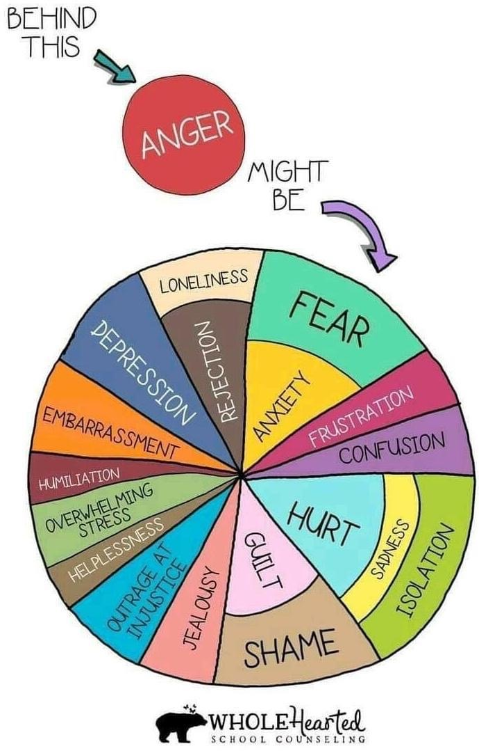

Slide 7
Approaches
This presentation offers an overview of several psychological theories that can be applied within schools to support the needs of the children/young people.
Building Positive Relationships
A
Nurturing School
Resilience
Psychosocial Care
Growth Mindset
Emotion Coaching
PACE Model
Attachment
Theory
Mindfulness
Notes:
It is not expected that all of these approaches should be used at the same time. They should be considered as a range of approaches that can be used to support children and young people.

Slide 8
The Importance of Relationships
Upon returning to school, a key area to think about will be the development and re-establishment of relationships. This will not only be for pupils with other pupils, staff with pupils and staff with each other.
It is suggested that schools focus on relationships first; how to support staff and pupils to connect when they have been separated as well as children and young people re-establishing friendships.
Younger children may need additional adult support in reminding them of how to play and interact appropriately with others.
Staff also need time to reconnect with each other where they feel safe, fit and ready so that they can model their behaviours towards children.
The development of relationships will then lead to feelings of belonging, and being safe, as well as the opportunity to re-affirm structures and routines.
Notes:
It is important that children and young people have time to re-establish their relationship with each other as well as the adults within the school environment. It is also important that the adults within school have the time to re-establish their relationships with each other. Schools should be flexible and think about how they will have a range of adults who can support children and young people at a time. This should not be timetabled or structured. In the first instance relatonships will be key in creating a safe and nurturing environment where children can be ready to learn and staff ready to teach.

Slide 9
Attachment Theory
As a result of the COVID-19 pandemic some children may have experienced trauma or further trauma. The impact of a trauma often depends upon its severity and timing.
Children whose caregivers respond sensitively and appropriately to the child’s needs at times of distress and fear are thought to develop secure attachments to their caregivers. They are thoughts to have better outcomes than non-securely attached children
We know that transition can prove to be difficult, even when children have secure and stable ‘backgrounds’, reinforcing the need to use attachment informed principles, universally, for all students. Additionally, the uncertainly of the coronavirus and the impact that this has had, such as routines being disrupted and/or family members being ill, may cause anxiety for children upon their return to school.
It is important that relationships with staff are re-established for all children. The school setting, as well as the adults that care for children and young people, need to be safe and secure bases, in order for them to be emotionally able and ready to learn.
Notes:
Observe attachment behaviours. Young children who are securely attached need to continue to experience an optimum level of support and nurturing care with their key adults. Children who are showing insecure or avoidant attachment behaviours need help building relationships.

Slide 10
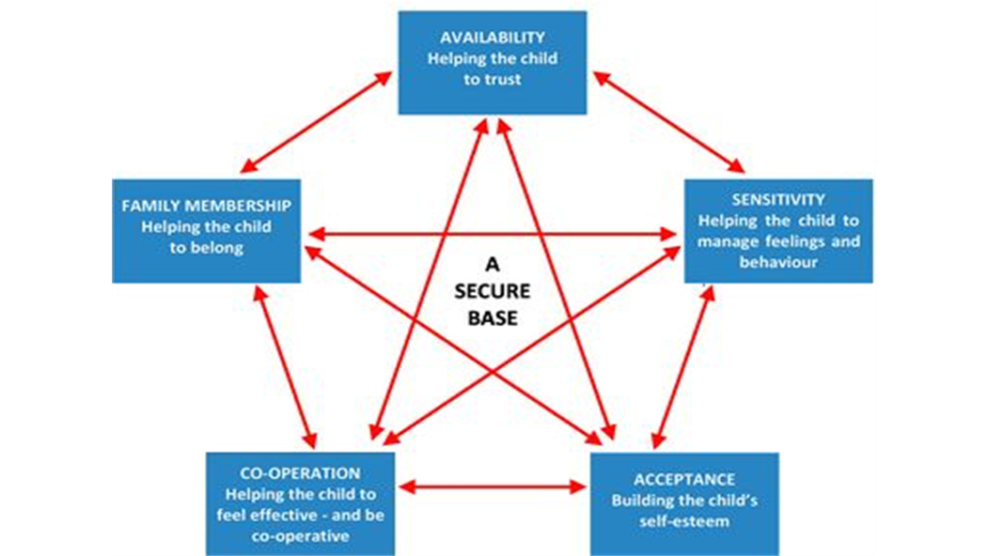
Attachment Theory
This diagram demonstrates the importance of schools being a safe base and how this can be achieved.
Children need experiences of being and feeling calm; believe that they are lovable and are loved; that others want to connect and interact with them; that others are interested in them and their thoughts/ideas; that they can be curious and make mistakes; that they are safe and that they can trust others to meet their needs.

Slide 11
A Nurturing School
Many staff will have heard of Nurture Groups. Many of the key principles of nurture groups can be implemented within the classroom.
There are six main principles of Nurture:
“A nurturing approach can be applied at both the universal and targeted level and promotes inclusive, respectful relationships across the whole school community, including learners, staff, parents/carers and partners.” (Education Scotland).
1
Learning is understood developmentally
6
The importance of transition in the lives of children and young people
2
The classroom offers a safe base
Nurture
Principles
5
All behaviour is communication
3
The importance of nurture for the development of wellbeing
4
Language is a vital means of communication

Slide 12
A Nurturing School
A nurturing approach recognises that positive relationships are central to both learning and wellbeing.
A key aspect of a nurturing approach is an understanding of attachment theory and how early experiences can have a significant impact on development.
It recognises that all school/EYS settings staff have a role to play in establishing the positive relationships that are required to promote healthy social and emotional development and that these relationships should be reliable, predictable and consistent where possible.
A nurturing approach has a key focus on the school environment and emphasises the balance between care and challenge which incorporates attunement, warmth and connection alongside structure, high expectations and a focus on achievement and attainment.
Taken from ‘Applying Nurture as a whole school approach’ – Education Scotland
https://education.gov.scot/improvement/Documents/inc55ApplyingNurturingApproaches120617.pdf
Notes:
Again, the key approach is the development and maintaining of relationships

Slide 13
Resilience
Resilience is the ability to ‘bounce back’ from adversity.
Resilience is not a personality trait. Innate characteristics play a part, but resilience is something that can be promoted and developed, through the provision of support and opportunities for growth.
Whole school resilience based approaches are more likely to have long-term positive benefits than individual interventions.
The Resiliency Framework summarises a set of ideas and practices that promote resiliency. The Framework is split into five headings or sections; Basics, Belonging, Learning, Coping and Core-Self. Within each element there is a range of evidenced based ideas that can be used in supporting resiliency within children and young people.
The resiliency wheel is another approach which which identifies six major approaches to promoting resilience along with specific strategies. The most critical part in this model is again through relationships.
Notes:
The key with resilience is that it is something that can be taught, that can be developed and built on in schools. Using the following frameworks allow staff and adults to plan accordingly. A more resilient child or young person is more likely to be able to deal with other difficult situations that arise and give support to others.

Slide 14
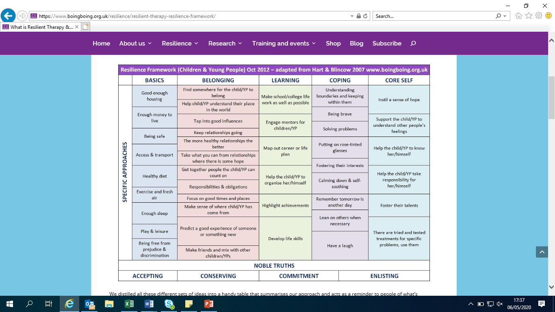
A copy of the Resiliency Framework can be found at www.boingboing.org.uk

Slide 15
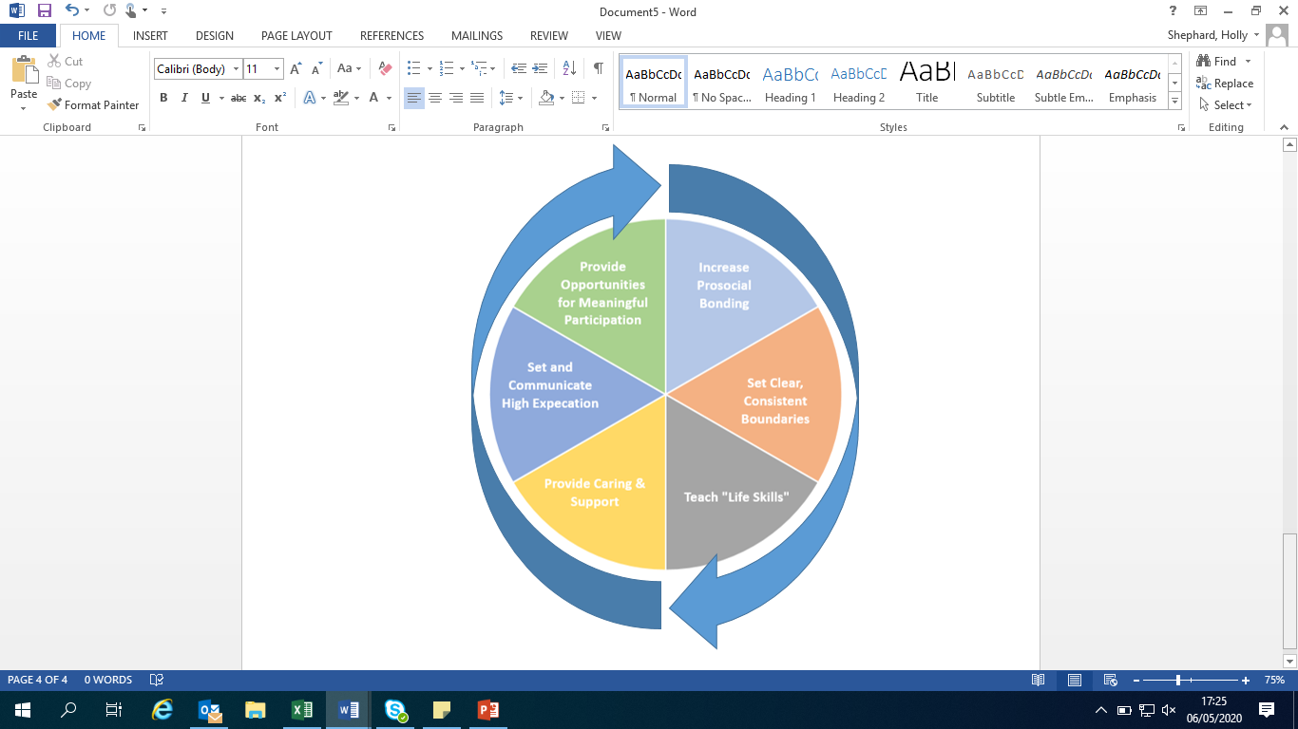
The Resiliency Wheel
Adapted from the book Resiliency in school: Making It Happen for Students and Education by Nan Henderson and Mike Milstein, published by Corvin Press, Thoussand Oaks, CA (1996)
Notes:
Again it should be noted that one particular piece of the wheel is highlighted – this is to indicate the importance of providing care and support as without this, very difficult to achieve the other components.

Slide 16
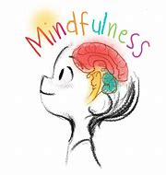
Mindfulness
Mindfulness is the quality of being present and fully engaged with whatever we’re doing at the moment, free of distraction or judgement and aware of thoughts and feelings.
Mindfulness can help children and young people to regulate their emotions and focus their attention as well as developing their resilience. Furthermore, it can open a channel of discussion with adults on discussing any thoughts worries and concerns.
Notes:
This is something that can be easily established within the classroom routine. There are lots of apps and websites that can be accessed to support this.

Slide 17
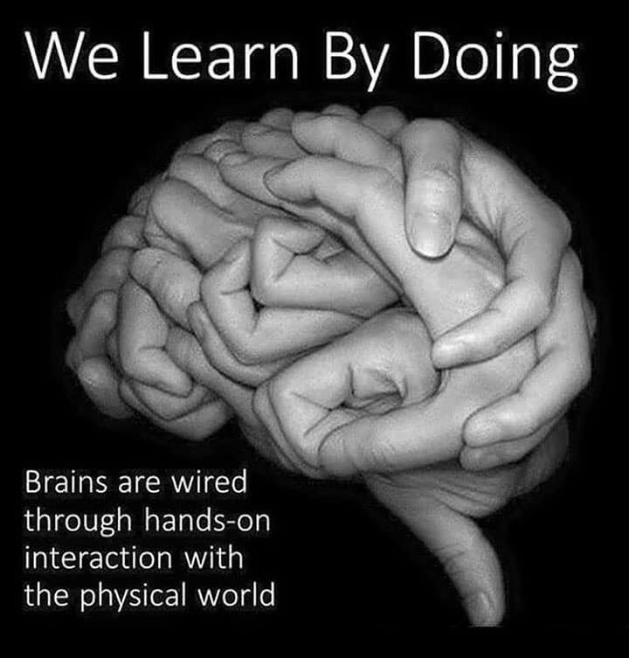
Emotion Coaching
Emotion Coaching is an evidence-based strategy based upon the work of John Gottman.
Emotion Coaching uses moments of heightened emotion and resulting behaviour to guide and teach the child and young person about more effective responses.
Through empathetic engagement, the child’s emotional state is verbally acknowledged and validated, promoting a sense of security and feeling ‘felt’. This activates changes in the child’s neurological system and allows the child to calm down, physiologically and psychologically.
Many Herefordshire schools have been trained in the Emotion Coaching approach and further information is available from the EPS on request.
Notes:
Wakefield EPS are offering a full day’s training for all staff on emotion coaching. Please speak to your named EP about this training which can be delivered in an INSET day or over two twilights.

Slide 18
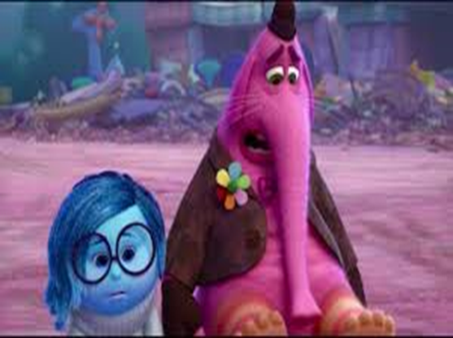
Emotion Coaching involves..
Teaching children about the world of emotion ‘in the moment’
Giving children strategies to deal with ups and downs
Accepting all emotions as normal
Seeing undesired behavioural responses as opportunities for teaching
Building trusting and respectful relationships

Slide 19
Psychosocial Care
Research has identified five key principles that support recovery following a disaster or serious incident (Hobfoll et al., 2007). These principles will be important to consider when supporting members of staff, children and young people upon their return to school:
A sense of safety: It is important that adults, children and young people feel safe upon their return to school.
A sense of calm: Children and young people are likely to experience a range of emotions including both pleasant and unpleasant emotions. It is important that these are normalised and they are given support to help them manage their emotions and return to a state of calm.
A sense of self- and collective- efficacy: Children need to feel they have some control over what is happening to them.
Social connectedness: It is important that adults, children and young people feel they belong and have a social network who can support them within the educational setting.
Promoting hope: Whilst things may feel difficult at the moment, it is important that adults, children and young people feel things will get better and work out in future. They need to be provided with reassurance, and understand that in the long term they will feel positive again.

Slide 20
The ‘PACE’ Model
PACE can be used by any adult to validate, explore and understand children’s feelings.
The approach was developed by Dr Dan Hughes, a clinical psychologist
PACE = PLAYFULNESS, ACCEPTANCE, CURIOSITY and EMPATHY.
Playfulness
An open, ready, calm, relaxed and engaged attitude
Acceptance
Unconditionally accepting a child makes them feel secure, safe and loved
Curiosity
Without judgement children become aware of their inner life
Empathy
A sense of compassion for the child and their feelings
Notes:
It is an approach, which limits shame, promotes compassion and brings a sense of mutual support, strength and resilience. When an adult spends time with a child and demonstrates an interest I their inner life, they contain and regulate the child’s emotions so that they can learn to do this themselves.
To find more information about the PACE model please go to https://ddpnetwork.org/about-ddp/meant-pace/

Slide 21
Growth Mindset
A growth mindset refers to the belief that abilities and knowledge are not fixed and that with effort, experience and support, we can achieve growth. In contrast, those who have a fixed mindset are of the view that their qualities are “carved in stone” and are unchangeable.
Research has shown that when children have a growth mindset they more willing to take on challenging tasks, focus on learning goals and able to rebound more easily from failures.
Growth mindset will be important and useful for staff to foster when children return to school. It is highly likely that children will feel overwhelmed with academic work, following the unexpected break from school, despite home learning. As such, the key messages and strategies that we can take from growth mindset will reassure and support them that the difficulties they experience now can be mastered.
The power of the word ‘yet’ is a quick and easy way to promote a growth mindset. For example, “you cannot do that maths question yet but you will get there”.
(Dweck, C; 2006)
Notes:
Growth mindset challenges children and young people to re-frame their thinking with a more positive outcome. Again, there are lots of resources available on the internet to support a growth mindset classroom

Slide 22
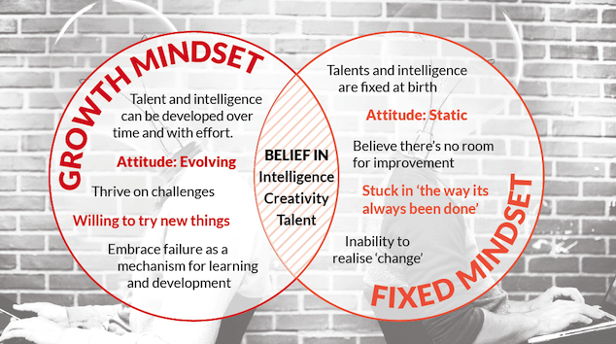

Slide 23

A Final Thought
What all of these psychological theories have in common is the importance of positive relationships that children and young people have with adults in school.
Taking time at the beginning to either start or re-establish relationships not only with the adults, but with each other will help children and young people to feel safe, secure and connected with the school community, which in turn will promote a whole school approach enabling all to be ready to learn.
Notes:
This will be the key for how children, young people and adults return to the school environment. We may never return to ‘normal’ but as a school community working with each other it will be possible to establish a new way of working.

